Slide 1
Policy Development Introduction July 2025

Slide 2
Policy Engine Overview

Slide 3
What are we doing here?
This is a high-level overview of the Policy Template Language and how to develop in it.
The intended audience is someone with a passing familiarity with using Policy Templates in Flexera One but no knowledge of how to create or modify them.
A more in-depth, self-paced training is available on GitHub and is recommended for anyone that intends to develop or modify Policy Templates.

Slide 4
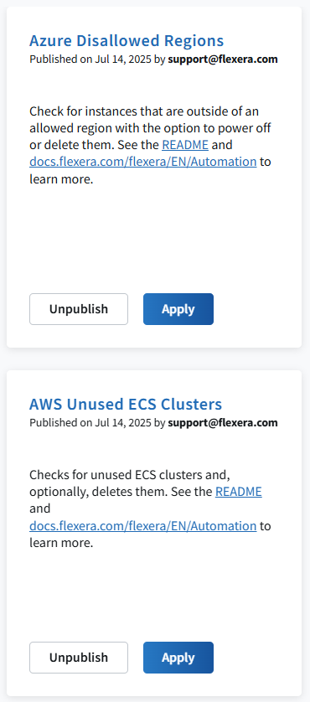
What is the Policy Engine?
The Policy Engine is a schedulable automation tool.
Policy Templates are scripts, written in a Domain-Specific Language in plain text, that can be scheduled to run on a specific cadence.
These scripts can be used to many different things:
Provide cost optimization recommendations.
Configure cost allocation using external sources of truth.
Email reports containing information stored in Flexera CCO.
And a lot more!

Slide 5
Policy Engine Interaction Chart
User
Remediation
Policy Template
Applied Policy
Gathers / Processes Data
Incident
Policy Catalog
Custom Template
Connect to APIs
Manipulate Data

Slide 6
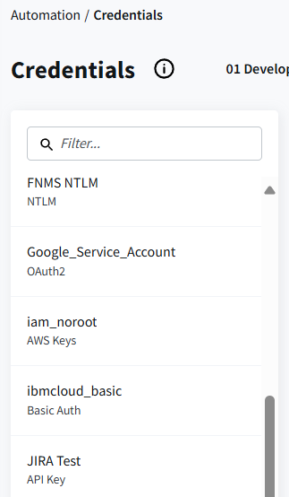
Requirements
Policy Templates need Credentials to connect to various REST APIs.
These credentials can be added in the Automation → Credentials section of Flexera One.
Typical forms of REST API authentication, such as username/password and oauth2, are supported.

Slide 7
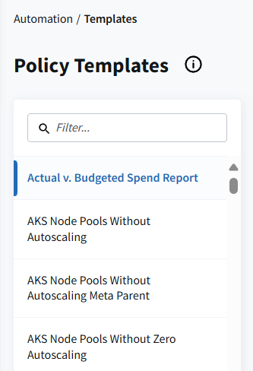
Using Policy Templates
Flexera has a large catalog of pre-built Policy Templates that can be accessed in the Automation → Catalog section of Flexera One.
Custom Policy Templates can be uploaded to the Automation → Templates section of Flexera One.
In both cases, using a Policy Template is as simple as selecting one, clicking Apply, configuring the settings as desired, and clicking Apply Policy.

Slide 8
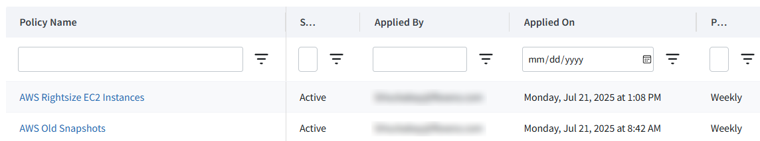
After Application
Once applied, an Applied Policy is added to the Automation → Applied Policies section of Flexera One.
This is where you can check the status of an Applied Policy, view logs, and view other relevant metadata.
This is also where you can change the schedule or the settings of an Applied Policy or terminate it.

Slide 9
Incidents
Most Applied Policies will raise an Incident if they find anything to report.
Incidents for a specific Applied Policy can be viewed on the Automation → Applied Policies section of Flexera One by clicking the name of an Applied Policy.
Incidents more generally can be viewed on the Automation → Incidents section of Flexera One.
When creating an Applied Policy, you can configure the Incident to automatically be emailed to a set of email addresses.

Slide 10
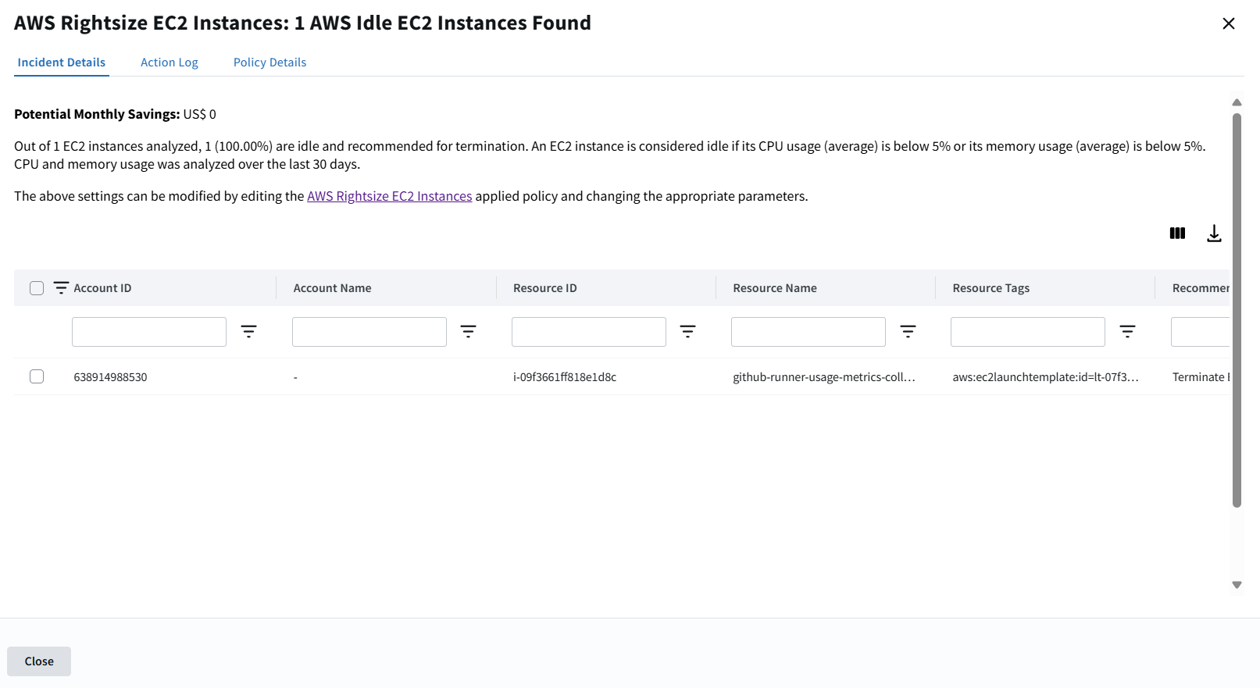
Example Incident

Slide 11
Behind The Scenes
When an Applied Policy executes, the associated Policy Template is parsed and executed by the Policy Engine.
During execution, the Policy Engine will connect to various REST APIs to gather data and execute JavaScript code within the Policy Template.
The resulting data is then validated to determine if there is anything that meets the criteria of raising an Incident. If there is, an Incident is raised and, if configured to do so, emailed.

Slide 12
Execution Flow: Idle AWS EC2 Instances
AWS API List EC2 Instances
AWS API List EC2 CPU/Memory Metrics
Raise Incident if applicable
Start
Finish
JavaScript Check EC2 Metrics for Low Usage

Slide 13
Policy Template Language

Slide 14
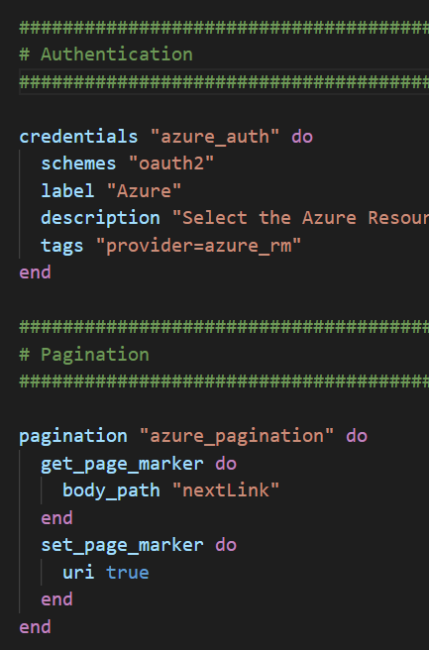
Policy Template Language
Designed to simplify automation with a straight-forward human readable language.
Resembles Ruby in how it is structured, with simple do-end blocks, but is not Ruby-based.
Arbitrary Ruby code is not supported.
Allows for arbitrary JavaScript code blocks to be used on an as-needed basis.

Slide 15
Basic Policy Template Layout
Metadata that describes the Policy Template.
Parameters that the end user can set values for when applying the Policy Template.
Credentials that enable the Policy Template to authenticate to various APIs.
Datasources that connect to those APIs to gather data.
Sometimes these will also execute blocks of JavaScript code to process, manipulate, combine, or filter data.
A policy block that will assess the specified datasource and will raise an Incident if a problem is found.
Optionally, escalation blocks will perform actions (either automated or manually triggered by the user) in response to the incident.

Slide 16
Fundamentals: Blocks
Policy Templates follow a straight-forward structure of code blocks.
Each block begins with a do statement, containing the type of block and the block’s name, and ends with an end statement.
Within the block, various fields can be defined. Depending on the type of block, some fields will be required while others will be optional.
Sometimes a block will be nested within another block, such as in the pagination example to the right.
Blocks can be referenced elsewhere in the policy by prefacing their name with $. For example, the credentials block here can be referenced with $azure_auth.

Slide 17
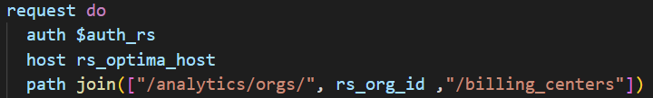
Fundamentals: Variables
Blocks can be referred to when needed by adding $ to their name. For example, $azure_auth.
There are also various values that are part of the Policy Engine itself and not defined by a block. These can be referred to by their name without any $ or other special syntax.
In the below example, the Flexera One organization ID is invoked via the rs_org_id built-in value, and the hostname for Optima API requests is invoked similarly with the rs_optima_host value.

Slide 18
Fundamentals: Functions
Numerous built-in functions exist to perform calculations, string manipulation, and Boolean comparisons.
Functions are invoked via their name followed by the function’s parameters inside a () block.
In the below example, the join function is used to combine the elements of an array into a single string.
The official documentation contains a full list of functions available.

Slide 19
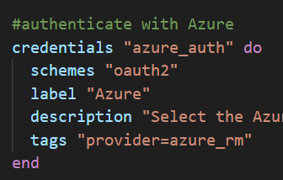
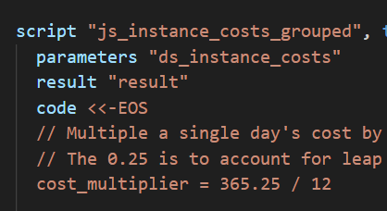
Fundamentals: Comments
Outside of JavaScript blocks, comments can be made by preceding a statement with a hash (#).
Within JavaScript blocks, comments can be made by preceding a statement with two slashes (//) or surrounding a statement with /* and */.
Example: // This is a comment
Example: /* This is all a comment even if it runs across several lines */
A comment can be on the same line as executable code if the comment is to the right of the code.
Example: cost = 1 // This is where we set the cost

Slide 20
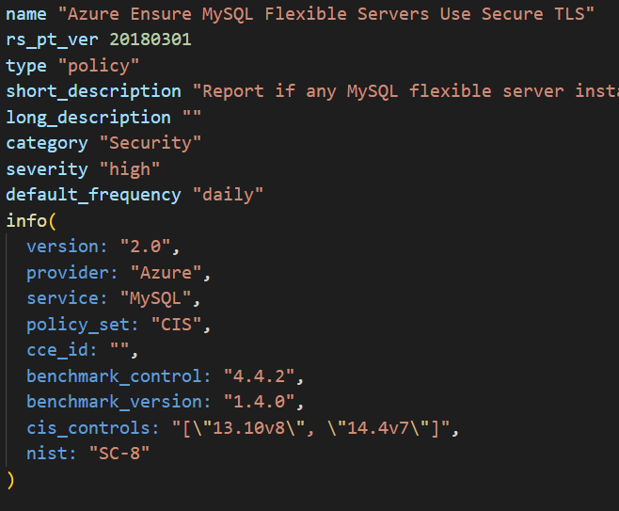
Section: Metadata
Should always be at the start of the Policy Template.
Contains basic info about the Policy Template, including name, category, etc.
rs_pt_ver is the version of the Policy Engine being used and should always be set to 20180301.
long_description is deprecated and generally left empty.
default_frequency and severity are default values; the user can select something else when applying the Policy Template.
info contains any other arbitrary metadata that is desired. At minimum, there should always be a version field here.

Slide 21
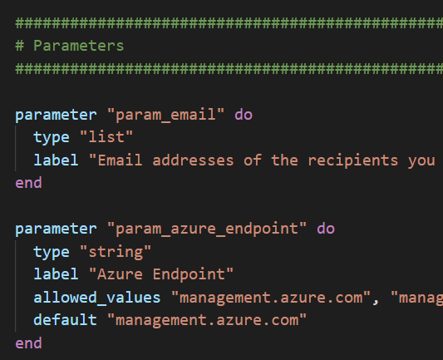
Section: Parameters
Parameters are variables that the user can provide when applying the Policy Template that will affect execution in various ways.
type can be a string, number, or a list.
allowed_values can be used if you want to force selection against several hardcoded options. allowed_pattern can be used to enforce conformity to a regex string.
default can be specified to save time when most users will not need to customize the policy.
Parameters can be referenced elsewhere in the policy with a $ followed by their name.
For example, $param_email would refer to the list of email addresses the end user specified when applying the policy.

Slide 22
Section: Credentials
Credentials specify the types of credentials needed to make API calls for the Policy Template.
When applying the Policy Template, the user will need to select a credential for each one in the Policy.
In this example, they would need to select a credential for Azure Resource Manager.
tags are used to indicate what kind of credential is needed. This is used to filter credentials in the UI when applying the policy so that only applicable credentials are shown.

Slide 23
Section: Pagination
Some REST API calls will return paged results.
Pagination blocks dictate how to handle pagination and can be referenced later on in the policy where applicable.
get_page_marker dictates how to determine what page is indicated in the API response.
set_page_marker dictates how to request the next page in the follow up API request.

Slide 24
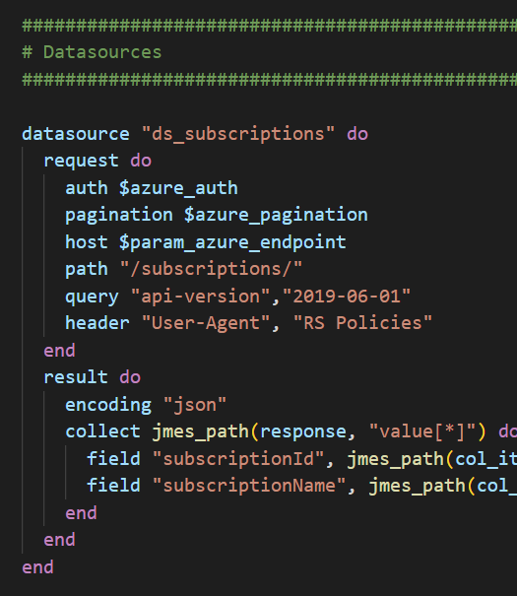
Section: Datasources
Datasources are used to gather data that can be processed or analyzed elsewhere.
Most datasources are for making REST API calls, but they can also be used to run arbitrary JavaScipt code.
The request block provides the details of the request.
The result block indicates how to interpret and organize the data provided in the response.

Slide 25
Section: Datasource Request Block
auth is used to indicate the credential to use, as defined earlier in the Policy Template.
pagination is used to indicate pagination in a similar fashion.
host is a string used to indicate the domain name that the REST API request is being sent to.
The rest of the options (verb, path, query, header, body, body_field) straightforwardly refer to their namesakes in the REST API request.

Slide 26
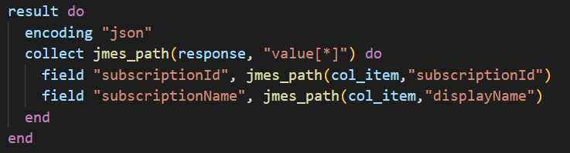
Section: Datasource Result Block
encoding indicates how the response is encoded so it can be interpreted correctly.
Options are json, xml, and text.
A collect statement can be used if the data is encapsulated within a specific key in the response but distributed across an array. This is common with some APIs.
field statements define what data to store in the resulting datasource and with what name.
In this case, we’re using the jmes_path function to obtain the contents of the subscriptionId field from the API response and store it in a field named subscriptionId in the datasource.

Slide 27
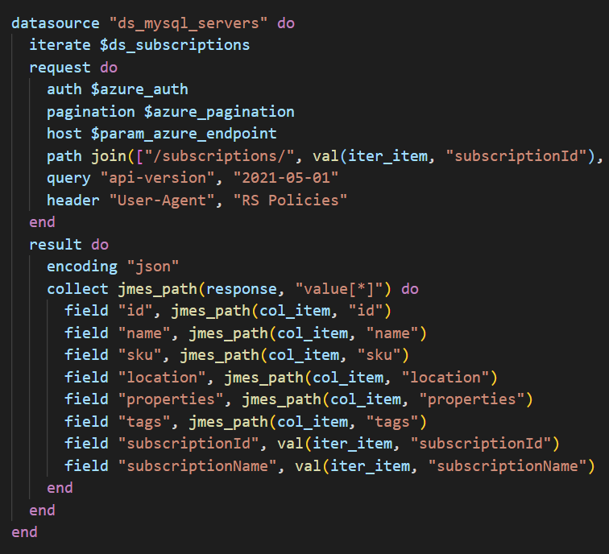
Section: Datasource Iteration
iterate is used to specify a previous datasource to iterate through.
The datasource in question must be an array of items for this to work.
A REST API request is made for each item in the datasource.
The keyword iter_item is used to refer to the individual item that is being iterated against.
The val function can be used to refer to specific fields in iter_item that might be relevant to the request.
In this example, the path of the request depends on the subscriptionId of each item we are iterating through.

Slide 28
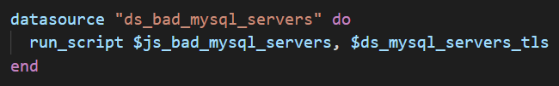
Section: Datasource JavaScript
Datasources can also be used to run arbitrary JavaScript code instead of making a REST API call.
This is commonly used to take data obtained from one or more datasources and consolidate or reorganize them in a more usable fashion, to perform calculations with the data obtained in the datasources, or to filter the data for specific entries.
run_script is followed by the name of the JavaScript block, followed by the parameters to pass to it.
These parameters can be Parameters specified by the end user, Datasources, or manually specified values.

Slide 29
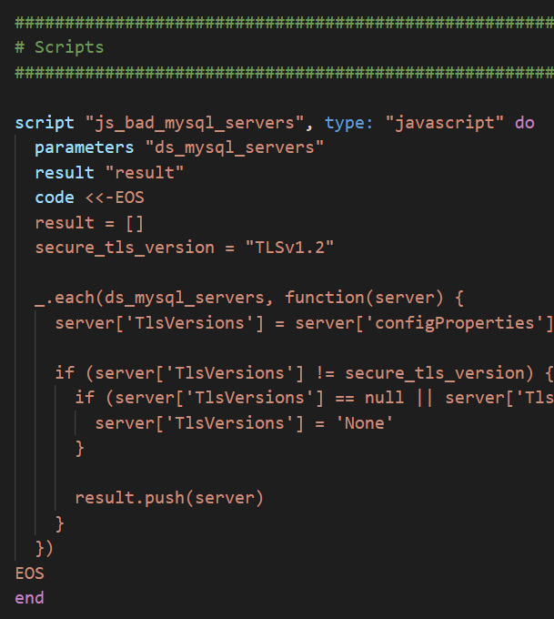
Section: JavaScript Blocks
script blocks enable arbitrary JavaScript code to be run. These blocks can be called from datasources.
parameters will list out the parameters sent to the script, which will then be variables that can be referenced and manipulated in your code.
result contains the name of the variable whose contents will be sent back to the datasource once the script has finished executing.
code contains a block of text with the script itself.
The underscore.js library is included, enabling functionality such as _.each.
https://underscorejs.org/

Slide 30
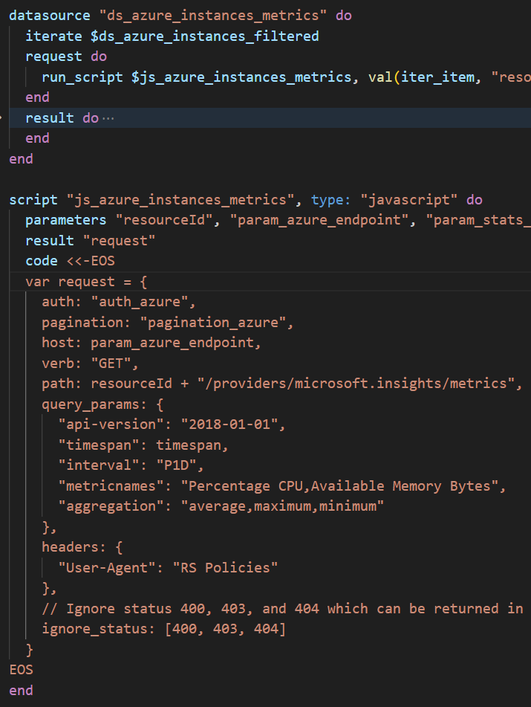
Section: JavaScript Request Blocks
Script blocks can also be used within a request block to generate a REST API request.
This can be useful for situations where some additional code might be needed to generate dates or other metadata that needs to be included in the REST API request.
The val function, along with the iter_item keyword, can be used to send in specific keys from whatever you are iterating across as parameters.
The result should be equal to an object with all of the relevant fields needed for a REST API request.
The script itself does not execute the API request. The script simply sends the details of the request back to the datasource where it is executed as usual.

Slide 31
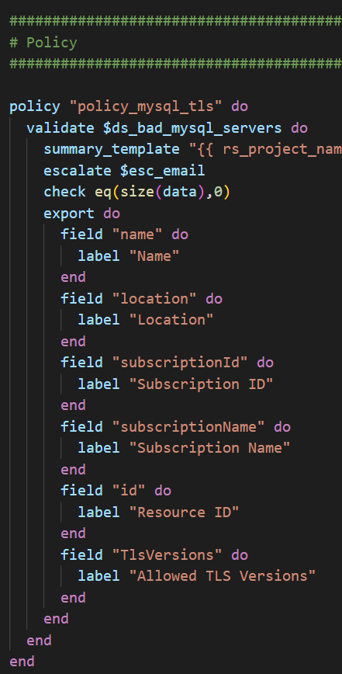
Section: Policy Block
The policy block is where incident-related information is specified.
A specific datasource is validated via a validate block.
You can use a validate_each block instead if you want to validate individual entries in a list instead of the entire list at once.
The check block contains a Boolean value that determines whether to raise an incident.
If using validate, the check statement runs against the entire datasource. If using validate_each, it runs against each individual item in the datasource list.
If using validate, an incident is raised if the Boolean value is false. If using validate_each, an incident is raised if the Boolean value is false for any items in the datasource list.
In this example, we’re assessing whether the datasource contains 0 entries via the size function and raising an incident if size(data) is not equal to 0 using the eq function.

Slide 32
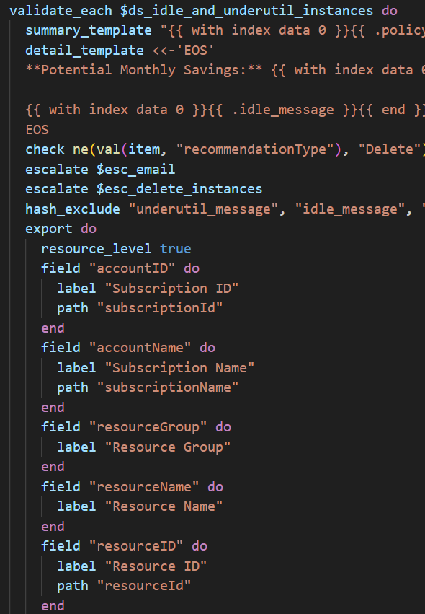
Section: Policy Block II
The summary_template contains the title of the incident that will appear on the Incidents page in the UI.
The optional detail_template contains additional information that will be shown above the incident table when viewing a specific incident in the UI.
Both the summary_template and detail_template support Golang-style templating to interpolate variables, such as policy parameters and data within the datasource being validated.
export is used to specify which fields in the datasource to include in the incident output and what to label them as.
A path statement can be placed within a field block to specify a different location than the field name for the data that should populate that field.
escalate specifies an escalation block, which can be used to send emails or run a Cloud Workflow Template.

Slide 33
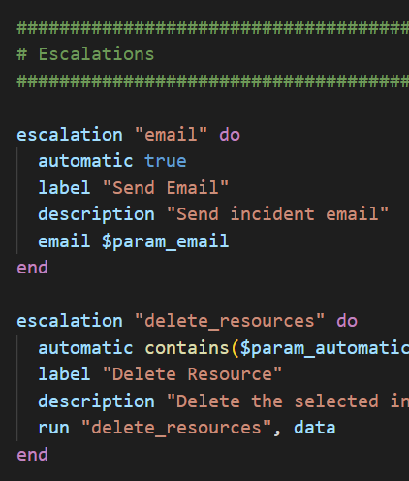
Section: Escalation
Escalation blocks contain information on what to do when an incident is raised.
Incidents will automatically appear in the Flexera One UI in the incidents section; this functionality requires no escalation block or code in the Policy.
automatic is followed by a Boolean value that determines if the escalation block should automatically execute.
email is used to send an incident email to the specified email addresses.
run is used to run a Cloud Workflow Template for automatic action or remediation.

Slide 34
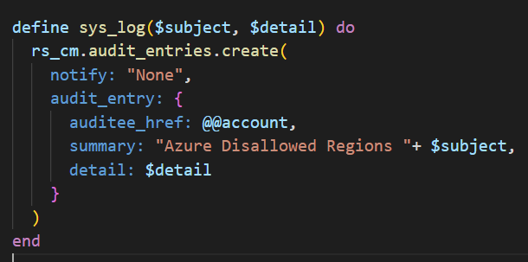
Section: Cloud Workflow
This optional section at the end of the Policy Template is where Cloud Workflow blocks can be defined in the Cloud Workflow language in order to manipulate cloud environments.
The Cloud Workflow Language is an Infrastructure-as-Code language used for Cloud Application Templates in Flexera One, but it can be utilized in policies as well.
An example use case would be automating the deletion of VM instances that have been powered off for an extended period of time.
Coverage of Cloud Workflow language is out of the scope of this presentation, but more information can be found here:
https://docs.rightscale.com/ss/reference/rcl/v2/index.html

Slide 35
Development Tools

Slide 36
Tools: General
A typical development environment is recommended, including:
Git or some other method of version control.
VSCode or a similar code editor.
Linting should be set to Ruby for correct coloration.
Access to a command line (bash, PowerShell, etc.)
Primarily for using version control and the fpt command line tool.
Local installation of node.js (for easy testing of JavaScript code)

Slide 37
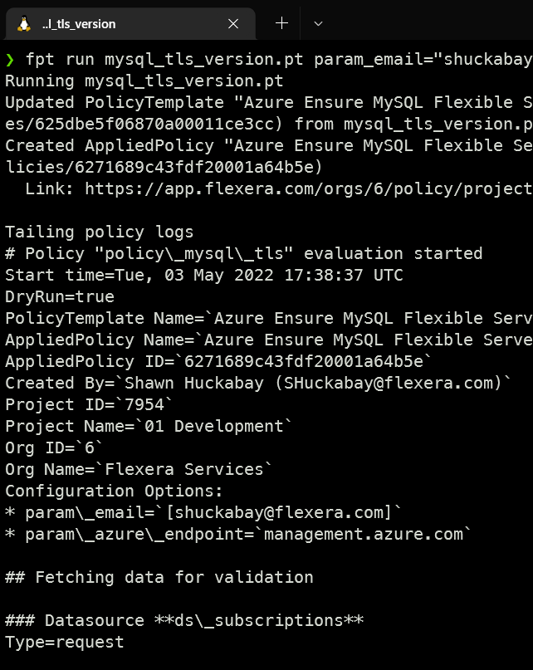
Tools: fpt
Command line tool provided by Flexera for Policy Template development.
Allows for easy testing and debugging of Policy Templates.
Available for Windows, macOS, and Linux.
Linux binary works within WSL2.
https://github.com/flexera-public/policy_sdk/blob/master/cmd/fpt/README.md

Slide 38
Learning Resources

Slide 39
Learning Resources
Policy Engine Development Training Course: https://github.com/flexera-public/policy_engine_training
Policy Template Language Documentation: https://docs.flexera.com/flexera/EN/Automation/AboutPolicies.htm
RightScale Docs: https://docs.rightscale.com/
Policy Developers Guide: https://docs.rightscale.com/policies/developers/
Cloud Workflow Language: https://docs.rightscale.com/ss/reference/rcl/v2/
fpt README.md: https://github.com/flexera-public/policy_sdk/blob/master/cmd/fpt/README.md
Underscore.js documentation: https://underscorejs.org/
Policy Catalog Repository: https://github.com/flexera-public/policy_templates

Slide 40
Q&A

